Slide 1
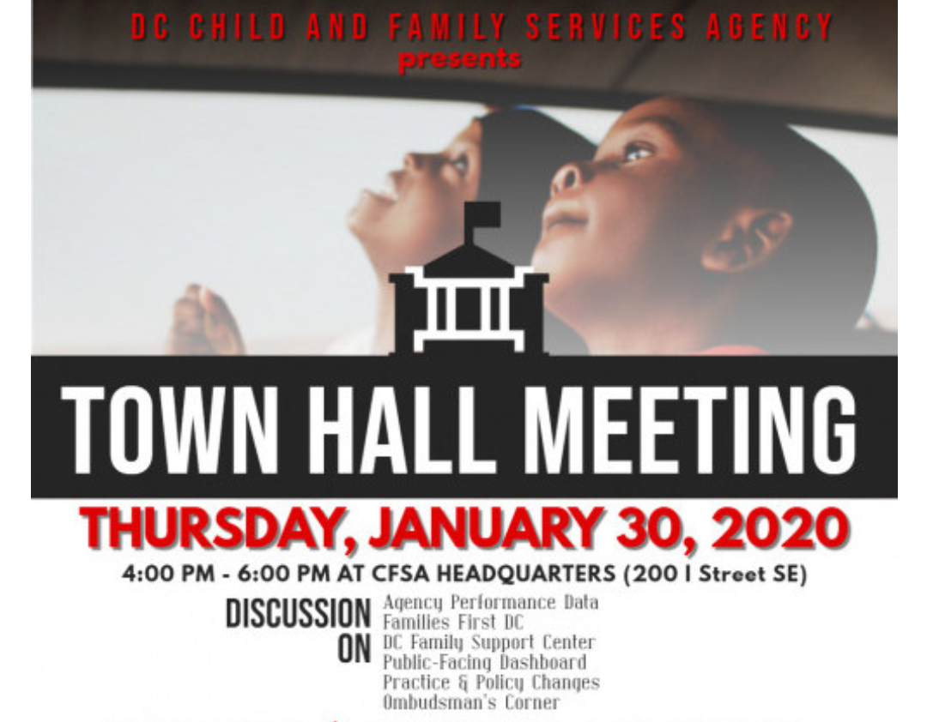
CFSA Public Town Hall Meeting
January 30, 2020
Notes:
Pull the thread through. Provide bold text from prevention plan throughout this document somehow.

Slide 2
Overview
Welcome & CFSA Overview
Prevention Services: Family First & Families First
Entry Services Data
CFSA Data Dashboard
Policy Update
Poster Themes
Wrap-Up
Notes:
Change this back to the graphic that the Director put in the budget.

Slide 3
Child Welfare – District Characteristics
Both local and state functions within CFSA
Partially privatized
Have always supported youth in care to age 21
All CFSA social workers are MSWs with licenses
Strong array of services and best practices
Relationships are key. CFSA is the agency. Numerous partners make up the system.

Slide 4
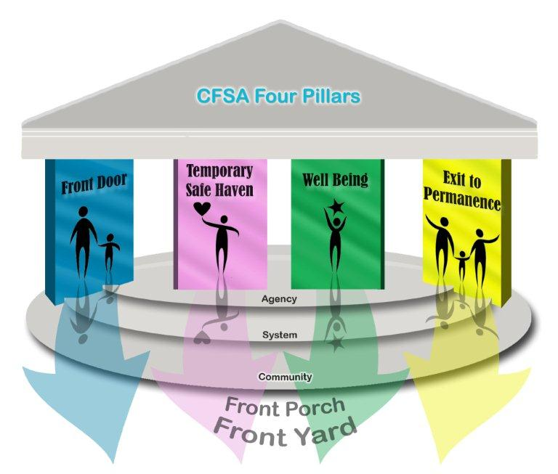
Four Pillars Agenda: Values-Based
Every child exits care as quickly as possible for a safe, supportive family or life-long connection. Older youth have skills for successful adulthood.
Children grow up best with their families. We remove children only when necessary to keep them safe.
Foster care is temporary. We start planning for permanence the day a child enters care.
Every child is entitled to a nurturing environment that supports healthy growth and development, good physical and mental health, and academic achievement.

Slide 5
Demographics
2144 children and youth served as of December 31, 2019

Slide 6
Children in Foster Care (as of 12/31/2019)
Notes:
Other includes: American Indian/Alaskan Native, Asian and Pacific Islander
Unknown includes: Unable to Determine or Not Reported
FY19 Q1 (as of 12/31/18)
Gender: Female= 48%, Male=52%
Race: AA=88%, White=3%, Other= 1%, Unknown=8%
Ethnicity: 14% Hispanic
Age: 0-6 = 33%, 7-12=24%, 13-18=31%, 19-21=12%

Slide 7
Trends
District In-Home Cases
First day of FY12 51% of caseload | Last day of FY19Q4 64% of caseload
Decline in children in care is leveling off
Children in District Out-of-Home Care
Point in time: Last day of fiscal year

Slide 8
Trends
Majority of District children in care in family settings (foster/kinship)
Placements roughly split between DC and Maryland
Placement Settings as of 12/31/2019
Family setting | 81%
Group home | 6%
Independent Living | 1%
Residential treatment | 3%
Other* | 8%
50%
46%
*Hospital, youth detention, short-term shelter, etc.
Notes:
“Other”- rounded up from 7.7%. Percentages may not total 100% since they are calculated across case types by dividing the respective case type subtotal by the overall foster care population.
FY19 Q1
Family setting = 82%
Group home= 6%
Independent Living= 2%
Residential treatment= 2%
Other*= 8%
MD= 384 / 849 = 45%
DC= 440 / 849 = 52%

Slide 9
Increased Focus on Prevention

Slide 10
Prevention Services

Slide 11
Family First Prevention Implementation
October 1, 2019 launched CFSA’s Five-Year Family First Prevention Plan to increase
preventative services to keep children safely with their families and out of foster care.
Implementation Highlights:
Additional tools available to assist families before they come into care via referrals to:
Healthy Families Thriving Communities Collaboratives (Collaboratives)
Evidence-Based Programs (partner with DC Health/Department of Behavioral Health & other services.
Implemented two IT system applications:
FACES: CFSA Case Workers develop child-specific prevention plans to refer to Evidence Based Practice (EBP) services, facilitate the transfer of referrals and cases to the Collaboratives directly from FACES, and automatically create Motivational Interviewing referrals for all In-Home cases.
CFSA Community Portal: Collaborative Partners and EBP Service Providers manage case transfers and EBP referrals from CFSA via FACES. Collaboratives can order Evidence Based Practice (EBP) services and EBP service providers can better track service referrals.

Slide 12
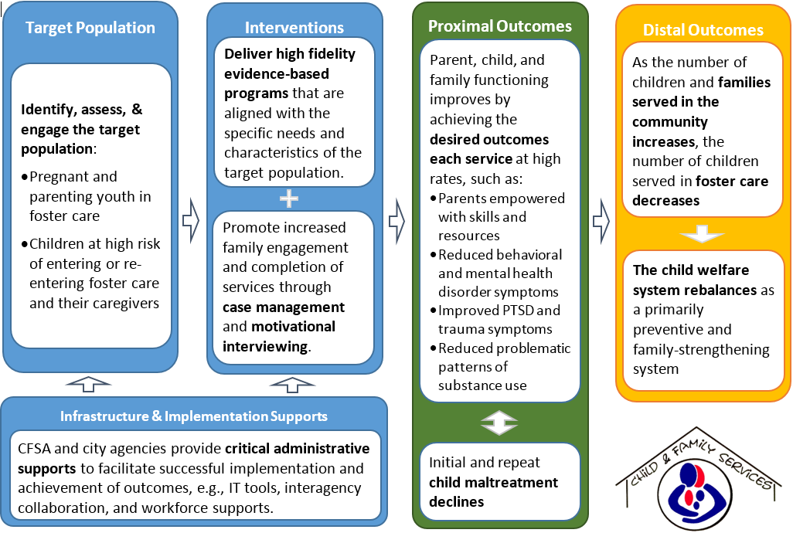
Theory of Change

Slide 13
Family First Target Population
Target Sub-Populations
Front Porch
(1) Children served through the Healthy Families/Thriving Communities Collaboratives (the Collaboratives) following a CPS investigation or closed CFSA case.
(2) Children who have exited foster care through reunification, guardianship, or adoptions.
(3) Children born to mothers with a positive toxicology screening.
Front Door
(4) Children served through CFSA’s In-Home Services program, which offers intensive case management and service referrals to families.
(5) Pregnant or parenting youth in/recently exited foster care with eligibility for services ending five years after exiting foster care.
(6) Non-ward children of pregnant or parenting youth in or recently exited foster care with eligibility for services ending five years after exiting.
(7) Siblings of children in foster care who reside at home and have assessed safety concerns.

Slide 14
Family First (CFSA) + Families First DC
Family First
Families First DC: Moving Upstream
Evidence-based programs to support pregnant & parenting youth in foster care and foster care candidates
Families First DC:
Neighborhood-based strengthening approach
Wraps around the narrow requirements of Family First to support and strengthen DC families in their own neighborhoods through primary prevention.

Slide 15
Families First DC: Goals
Empower Communities - Place-based approach - neighborhoods and families; services via Family Success Centers to meet their specific needs.
Community Advisory Council to set priorities, $400,000 grants including up to $250,000 for sub grants to fill services gaps.
Integrate Services –Centers will be uniquely designed by each community to facilitate access to existing government and community resources tailored to meet families’ needs
Focus Upstream - Family Success Centers will focus on increasing protective factors and mitigating trauma - prevent crises through early engagement.

Slide 16
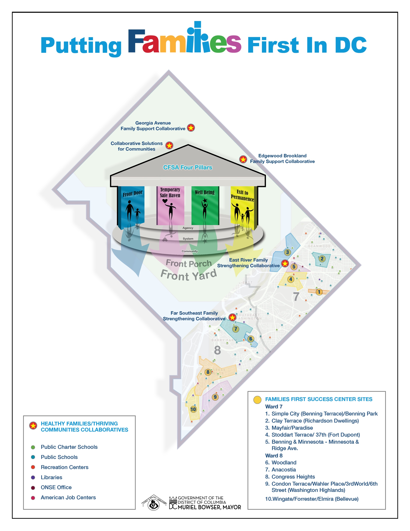

Slide 17
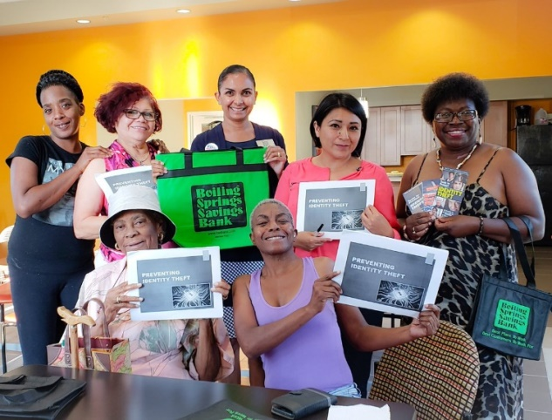
Families First DC: 10 Family Success Centers in Targeted Neighborhoods

Slide 18
Entry Services
Balancing Practice, Data & Compliance

Slide 19
Entry Services Priorities
80% of investigations will be of acceptable quality as measured by a qualitative review and verified by the Monitor
90% of investigations will be completed and a final report of findings shall be entered in FACES within 35 days
Timely Initiations
Timely Closures
Caseloads
Acceptable Investigations
Quality Service Reviews
Progress & Improvement
95% of all investigations will be initiated within 48 hours or there will be documented good faith efforts to initiate
90% of investigators and social workers will have caseloads that meet the above caseload requirements
80% of the in-home sample will have an acceptable rating on two QSR indicators: Supportive Services and Safe Case Closure
Notes:
Cheryl

Slide 20
Entry Services Strategies & Goals
Marry Practice and Data
Develop an internal and sustainable CQI process
Collaboratively develop strategies to enhance practice and operations
Utilize quantitative and qualitative information to support practice; prioritizing safety
Increase Accountability
Increase Performance
Shift organizational culture
Performance
Compliance
Quality

Slide 21
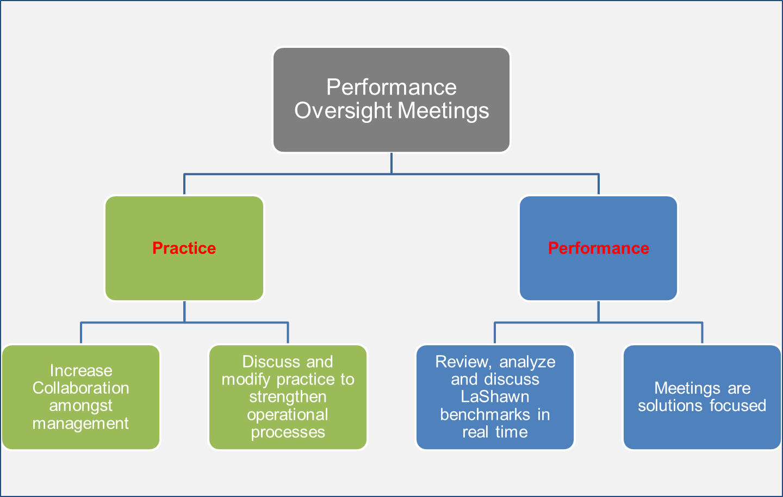
The Framework
The Framework
Prevention
Weekly meetings include PA, PMs, SSWs & Data Analyst

Slide 22
Timely Initiations
Benchmark; 95%
Challenges/Barriers
Referrals assigned after Good Faith Efforts (GFE) expired
Referrals scheduled to initiate during the weekends are not initiated
2nd home visit or school visit is not attempted
Individual worker performance
Note: Chart reflects compliance pre-audit

Slide 23
Timely Closures
Challenges/Barriers
Staff Retention
Individual Worker Performance Issues
Reassigned Referrals
General Late Closures
Backlog
Transition from Family Assessment to Investigations
Benchmark; 90%

Slide 24
Timely Closures: Solutions/Strategies
Discuss late closures in detail, mitigating challenges and barriers in real time
Increased monitoring for reassigned referrals
Supervisions are targeted, and support increased performance
Added (2) mid-shifts for staff
Enhanced elements of the daily huddle to support transfer of referrals
Added forums such as weekly clinical consultations

Slide 25
Caseloads
In May 2019, CPS began to track caseloads weekly. With increased monitoring CPS consistently met the benchmark.
Benchmark; 90%

Slide 26
Strategies to Support Improvement
Acceptable Investigations
Timeline
In Jan 2019 Entry Services provided staff with in-depth AI training
Results of the Jan 2019 review were provided to staff and targeted feedback and support were provided
In Jan 2019, Supervisors began to present referrals during the weekly Performance Oversight Mtgs, which provided peer support and feedback prior to referral closure
In Jul 2019, AI trainings were expanded to include social workers
In Jan 2020, Entry Services enhanced the onboarding training model for new staff to include an overview of Acceptable Investigations

Slide 27
January 2019 Acceptable Investigations Review Reason(s) Investigation Not Deemed Acceptable

Slide 28
Quality Service Reviews
The QSR is a qualitative review that focuses on Continuous Quality Improvement (CQI)
The QSR embodies the Plan Do Study Act (PDSA) cycle of the CQI process
Through this cycle, evidence is used to drive clinical and administrative decisions

Slide 29
2019 Themes from cases reviewed
Extensive and complex mental health and trauma history for birth parents Domestic Violence Truancy issues for children Lack of appropriate services for families (specifically mental health and domestic violence) Delay in the implementation of services by external providers (mental health agency) Housing/homelessness Parents with prior involvement with CFSA as a victim child Extended family involvement Children with chronic health concerns Court involved cases

Slide 30
Performance on Key Indicators

Slide 31
Performance on Key Indicators Supports & Services

Slide 32
System Performance Teamwork, Tracking and Overall Practice

Slide 33
Performance Improvement 2017 - 2019
2017
Engagement of birth fathers
2018
Assessment of Birth Fathers
2019
Assessment of Birth Fathers
Assessment of birth fathers
Team work and coordination
Pathway to Case Closure
Supports and Services of birth fathers
Supports and Services for Birth Fathers
Pathway to Case Closure

Slide 34
CFSA Data Dashboard

Slide 35
Public Accountability
CFSA’s DASH Public Facing Data Portal

Slide 36
Office of Policy, Planning and Program Support
Policy Update

Slide 37
Online Policy Manual Access
– From the CFSA Internet
All published policies are accessible at https://cfsa.dc.gov/page/cfsa-online-policy-manual by key word search.

Slide 38
Governance & Guidance Types
Program Policies – Governance that directly impacts case practice (e.g., Investigations, Cell Phones for Youth in Care)
General Administrative Policies (GAP) – Governance and procedures that directly impact the managerial and organizational standards of the agency (e.g., Alternative Work Schedule, Vehicle Accountability)
Administrative Issuances – Interim guidance to establish minimum standards of practice while new policies or procedures are being developed.
Collateral Documents – Guidance documents that provide additional detail and instructions related to governance documents (e.g., FAQ, Tip Sheet, Business Process)

Slide 39
Narrowing the Front Door
Grandparent Caregiver Program (Policy Update)
Clarifies procedural elements during the application process
Close Relative Caregiver (New AI)
Expands the definition of “grands” to include aunts/uncles/siblings
In Home (Policy Update)
Clarifies the criteria for opening an in-home services case and for making a levels of care determination
Safety Plans (New Policy)
Guidance for social workers in developing a formal, written, short-term agreement with a child's caregiver(s) to address an immediate safety issue and prevent a home removal

Slide 40
Contact Us
The Office of Policy, Planning and Program Policy Unit welcomes your feedback on existing policies and those under development. Direct any and all comments/questions to:
cfsa.policies@dc.gov
or
Bev-Freda Jackson
Planning, Policy and Program Support Program Manager
(202) 724-7320 (office)
(202) 277-7191 (mobile)
bev-freda.Jackson@dc.gov

Slide 41
Poster Themes

Slide 42
Wrap Up

Slide 43
Information
DC Council Committee on Human Services - CFSA Performance Oversight Hearing
February 12, 2020 @ 11:00 a.m.
Listening Session: How to Better Serve Foster & Birth Parents
March 5, 2020 from 4:00 p.m. – 6:00 p.m. at CFSA Headquarters
RSVP at cfsalisten.Eventbrite.com
CFSA Budget Engagement Forum
March 25, 2020
DC Council Committee on Human Services – CFSA FY2021 Budget Request Hearing
April 2, 2020 @ 10:00 a.m.
Town Hall Feedback
Provide feedback at CFSATownHall@dc.gov

